Slide 1
The Sound Collector
By Emmanuel Colon
Senior Year
BAS CTSD Bachelor Program

Slide 2
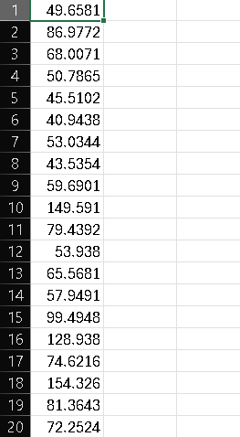
Project Description
The CPX’s microphone collects sound samples (magnitude)into a CSV file. Then I convert the file into a chart to view fluctuations over time.
The sound collected is the fan noise in my room’s fan noise, keyboard typing, or my voice.

Slide 3
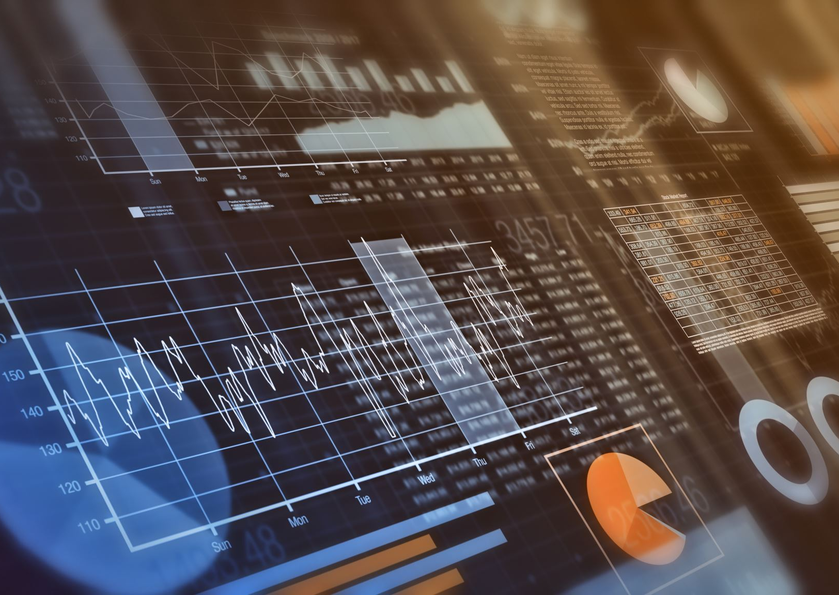
Languages & Tools used
Circuit Playground Express
Mu Editor (IDE)
Circuit Python program that collects samples into CSV.
Boot.py that allows writing to the microcontroller file system
Visual Studio Code (IDE)
Python program that converts the CSV into a basic graph.

Slide 4
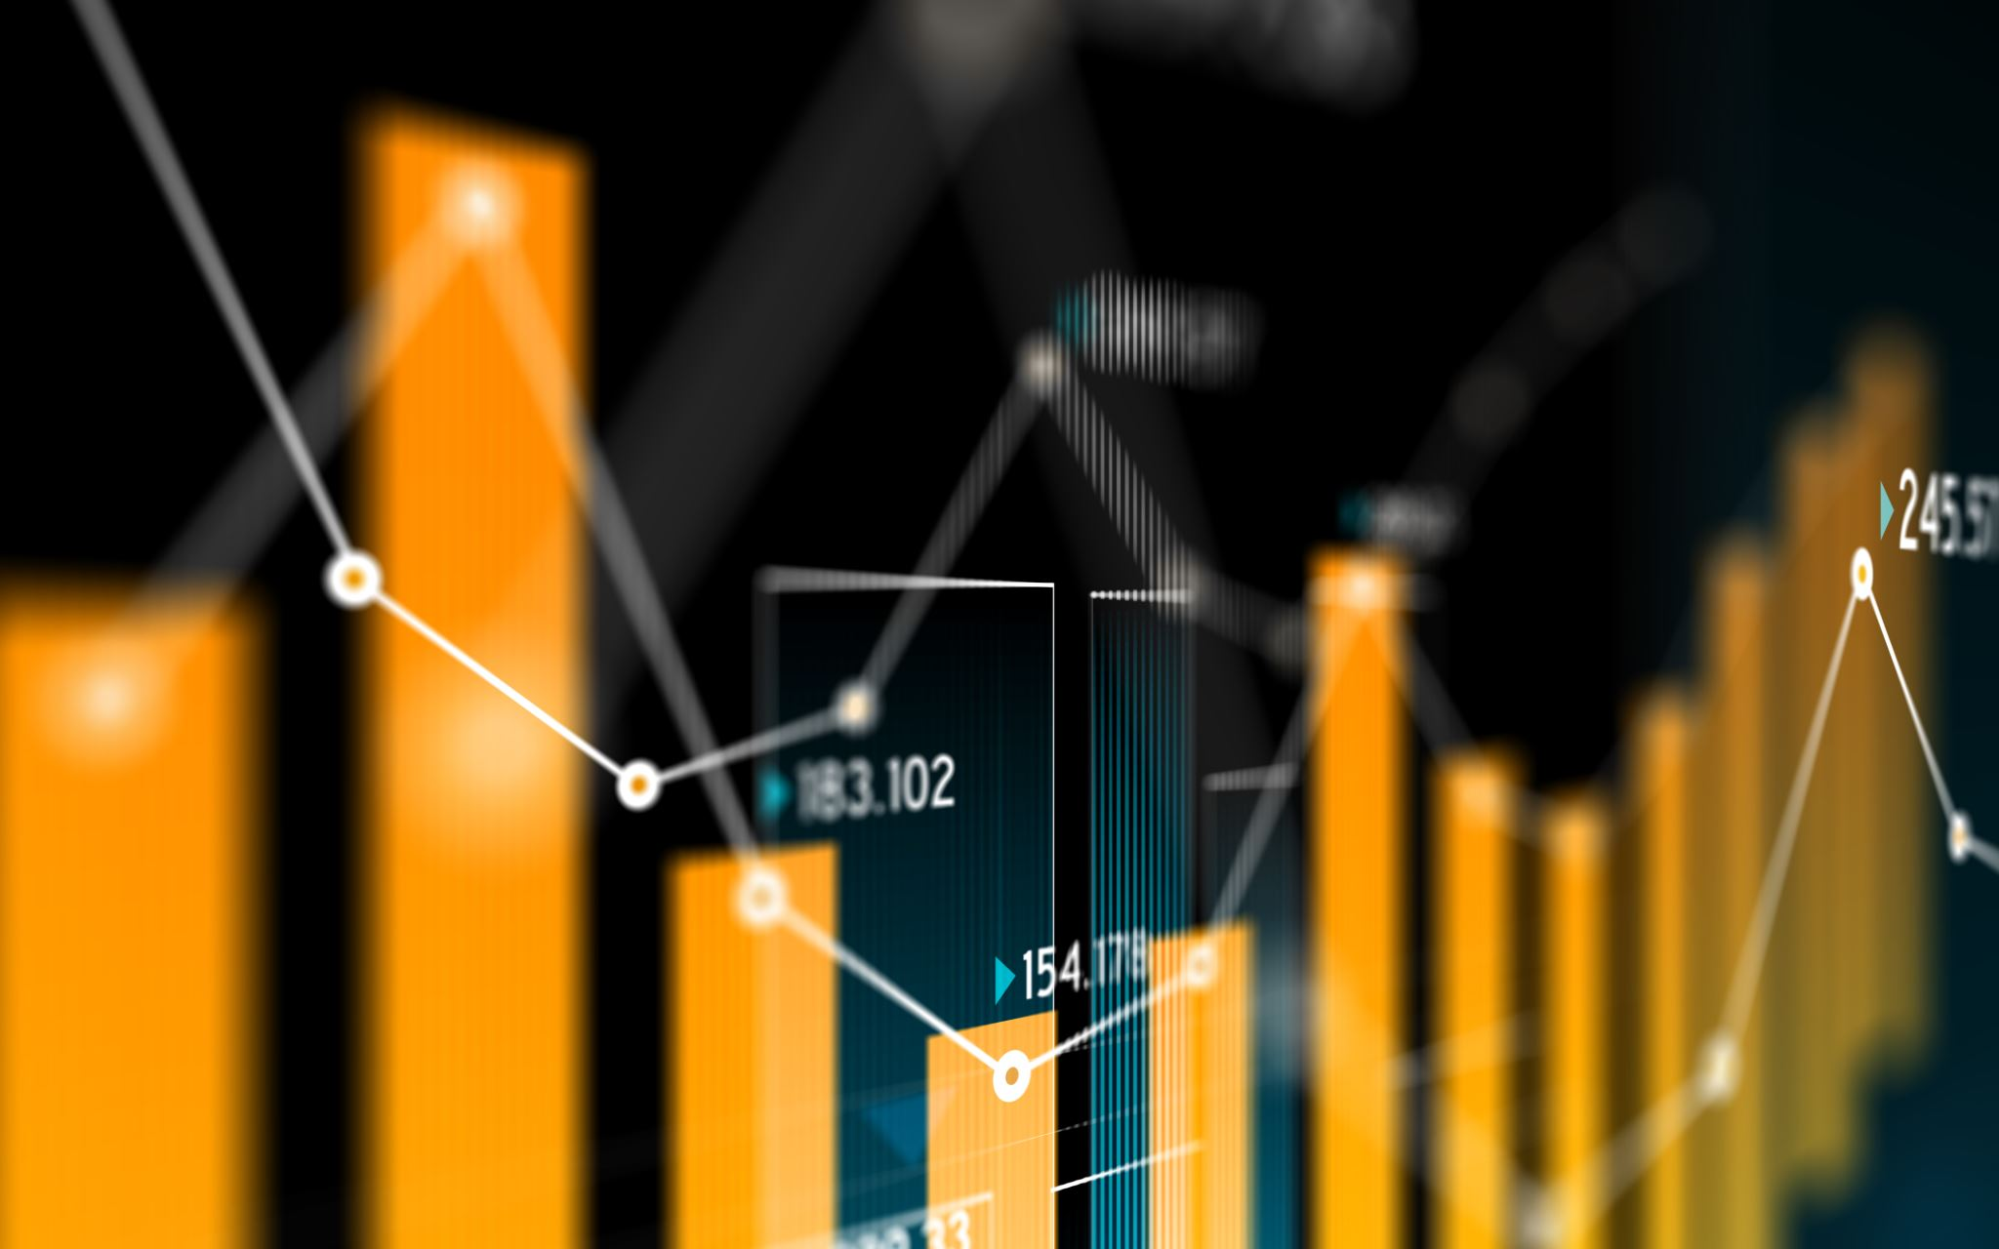
Implementation Changes
The Sound Collector’s scope has decreased for a simpler graph presentation.
However, it can theoretically write data to the CPX’s CSV file until it runs out of storage.
There will be twenty samples visualized in this demonstration. The fluctuations of magnitude will be easier to see.

Slide 5
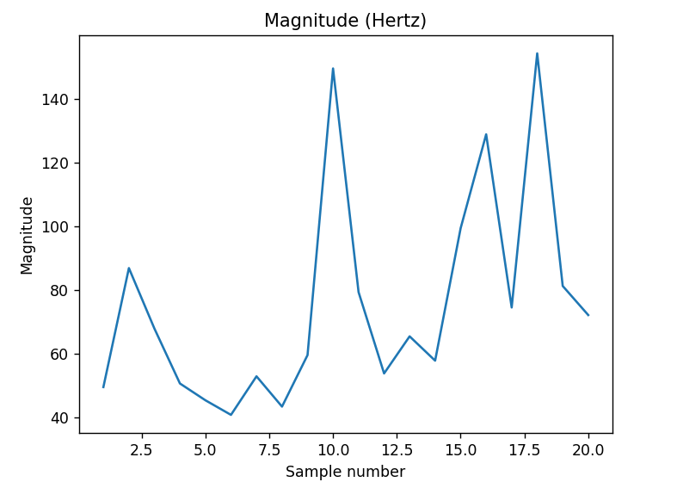
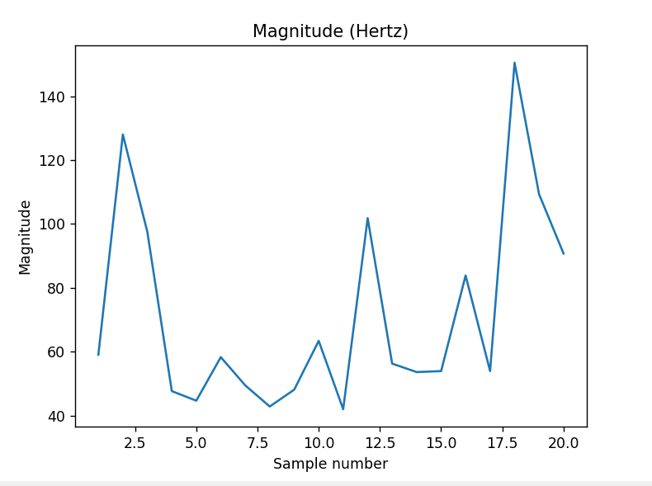
Findings & Results
Figure 1 – Extreme highs and lows
Figure 2 – More consistent

Slide 6
Technical Challenges
Inexperience with microcontrollers. Thankfully, I wasn’t completely alienated due to having Python experience, but it still took adjustments to how different Circuit Python can be in some circumstances.
The CPX filesystem’s read and write access. Adafruit doesn’t allow you to collect data to the board and edit the code simultaneously, or file corruption/ data loss may occur. Figuring out how to change that in boot.py without being locked out of the CPX was a challenge.

Slide 7
Successes & Disappointments
First Success: refactoring the tutorial’s audio sampling code into something I can understand and use.
Second Success: learning how to effectively use the CPX’s system remount to switch between writing to the board or editing code.
First Failure: figuring all of this out very late. It took lots of research to get it right and simplify every process of this project.
Second Disappointment: limited data collection due to the board writing directly to the filesystem. Ran out of time for a potential solution to write to my laptop’s files.

Slide 8
Project Do Over
I would start by fixing the disappointments mentioned in the previous slide.
Allocating my time more effectively and learning only what is necessary to complete this project in a more efficient manner.
I deem my current python programs satisfactory for this project, however I’d like to write data to my laptop instead of the board.
Overall, I wouldn’t change too much.

Slide 9
Thank you
In conclusion, I had a great experience learning about microcontrollers and what they can do.
This was a valuable learning experience that may prove useful in the future.

